Slide 1
Algorithm Design
Jamie Zhang

Slide 2
What’s your programming background?
Give you a set of random numbers:
2,6,15,3,7,1,19 for example
Could you give me a program/algorithm to sum all the numbers lower than 10

Slide 3
The program development life cycle
Analysis
Design
Coding
Testing

Slide 4
The program development life cycle
– Analysis: abstraction, decomposition of the problem, identification of the problem and requirements
– Design: decomposition, structure diagrams, flowcharts, pseudocode
– Coding: writing program code and iterative testing
– Testing: testing program code with the use of test data(maybe iterative testing)

Slide 5
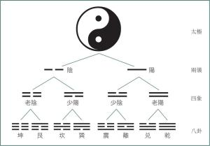
Analysis
A computer system is made up of software, data, hardware, communications and people; each computer system can be divided up into a set of sub-systems. Each sub-system can be further divided into sub-systems and so on until each sub-system just performs a single action.

Slide 6
Do all computer systems have similar sizes?

Slide 7
Decomposition
Top-down design is the decomposition of a computer system into a set of subsystems, then breaking each sub-system down into a set of smaller sub-systems, until each sub-system just performs a single action.
This is an effective way of designing a computer system to provide a solution to a problem, since each part of the problem is broken down into smaller more manageable problems.
The process of breaking down into smaller sub-systems is called stepwise refinement.

Slide 8
Decomposition
Inputs – the data used by the system that needs to be entered while the system is active
Processes – the tasks that need to be performed using the input data and any other previously stored data
Outputs – information that needs to be displayed or printed for the users of the system
Storage – data that needs to be stored in files on an appropriate medium for use in the future.

Slide 9
Design a solution
Structure diagrams
Flowcharts
Pseudocode.

Slide 10
Structure diagrams
Structure diagrams are hierarchical, showing how a computer system solution can be divided into sub-systems with each level giving a more detailed breakdown.
It’s on the Syllabus but not in the exam for several years.

Slide 11
Where do this type of solution commonly used and what might be the possible flaws?

Slide 12
In-class work
Use the structure diagram to draw a online shopping system

Slide 13
In-class work
User management（Registration/Login）
Shopping item viewer
Cart Management（Adding/Deleting goods）
Order Management（View/Cancel Orders）
Payment(Wechat/Alipay)
For the structure diagram, understanding the concepts of dividing the tasks is enough for the exam.

Slide 14
Flowchart
A flowchart shows diagrammatically the steps required to complete a task and the order that they are to be performed. These steps, together with the order, are called an algorithm
Flowchart flow lines use arrows to show the direction of flow

Slide 15
Flowcharts
Begin/Stop: Used at the beginning and end of each flowchart
Process: Show actions, for example, when values are assigned to variables.
Input/Output: Used to show the input of data and output of information.
Decision: Used to decide which action is to be taken next; these can be used for selection and repetition/iteration.

Slide 16
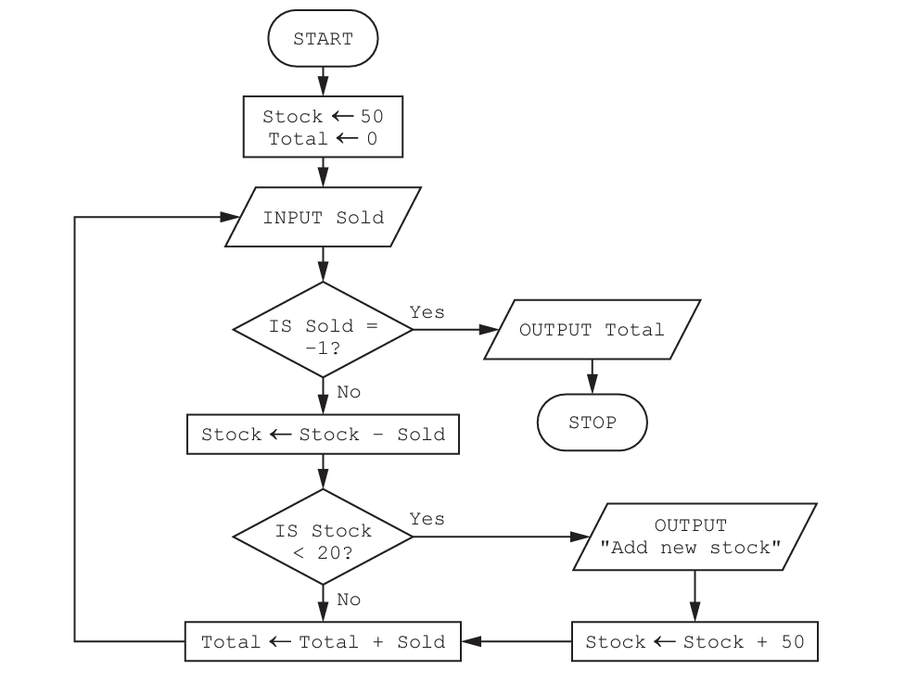
Paper 21, Nov 2022, q4

Slide 17
Paper 21,Nov 2023, q8
A programmer is designing an algorithm to calculate the cost of a length of rope. The program requirements are:
input two values: the length of rope in metres Length and the cost of one metre Cost
perform a validation check on the length to ensure that the value is between 0.5 and 6.0 inclusive
calculate the price Price
output the price rounded to two decimal places.

Slide 18
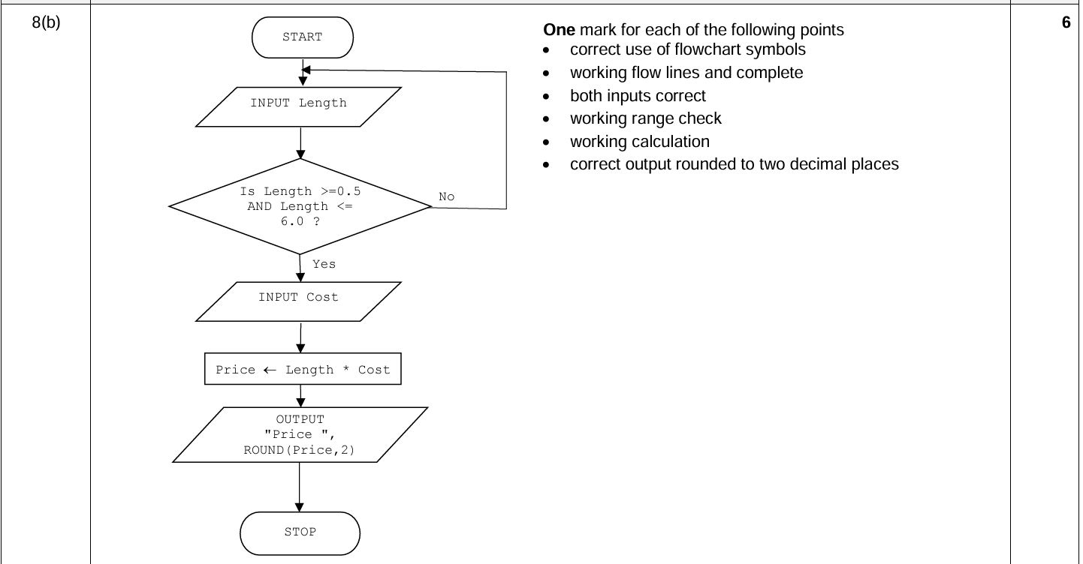
In-class work

Slide 19
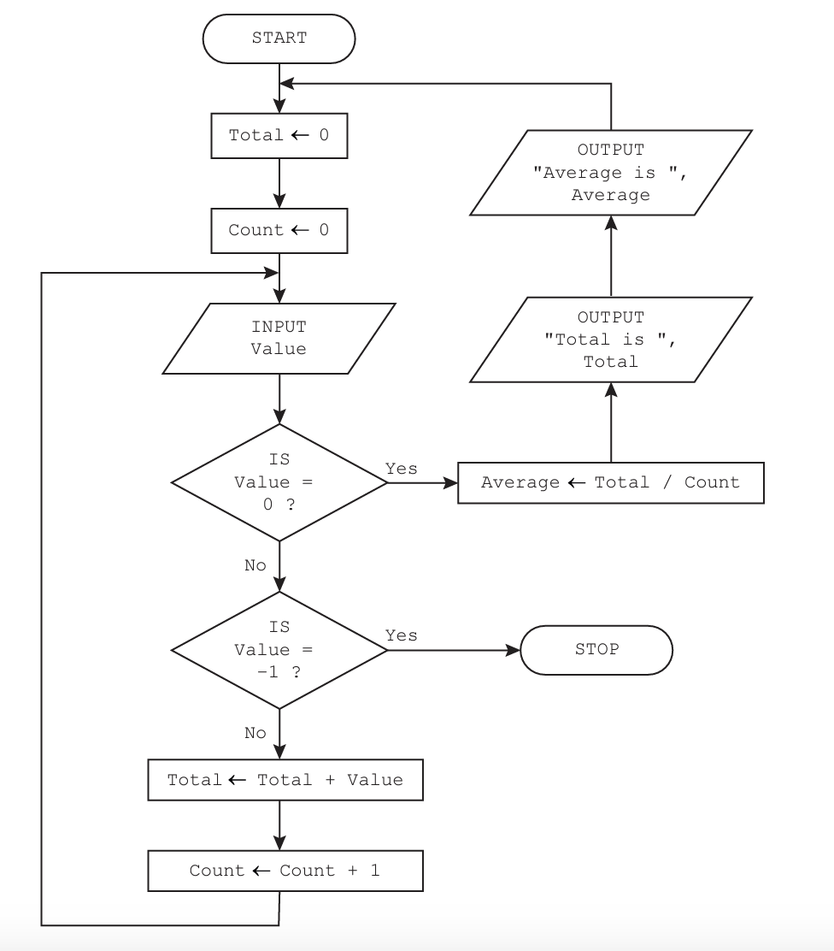
Paper 22, Nov 2023, q6

Slide 20
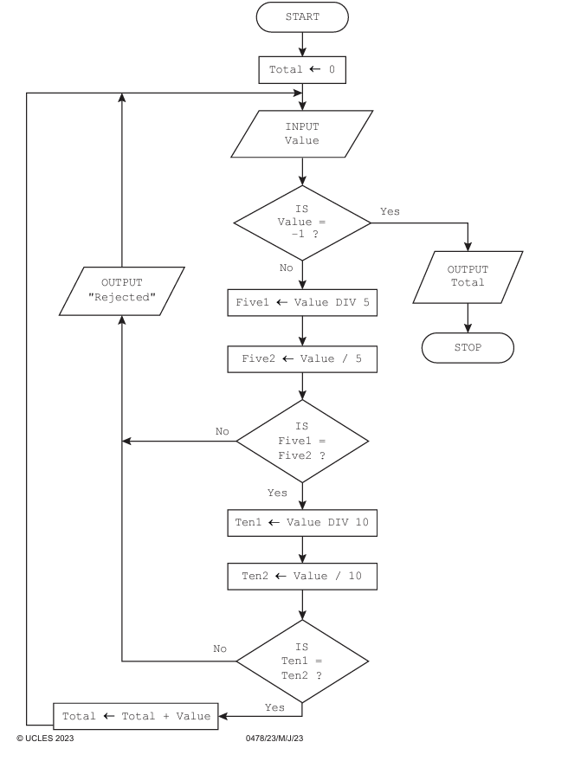
Paper 23, June 2023, q7

Slide 21
Pseudocode
Pseudocode is a simple method of showing an algorithm.
It describes what the algorithm does by using English key words that are very similar to those used in a high-level programming language.
Pseudocode is not bound by the strict syntax rules of a programming language

Slide 22
如果在我讲任何伪代码过程中有任何你觉得我写错了的地方，请直接纠正我

Slide 23
Pseudocode basics
<- assign a number

Slide 24
Pseudocode basics
+ Add
− Subtract
* Multiply
/ Divide
^ Raise to the power
( ) Group
What’s DIV?

Slide 25
Pseudocode basics
> Greater than
< Less than
= Equal
>= Greater than or equal
<= Less than or equal
<> Not equal
AND Both
OR Either
NOT Not

Slide 26
Pseudocode basics
INPUT
OUTPUT

Slide 27
Conditional Statement
IF...THEN...ELSE...ENDIF
CASE OF...OTHERWISE...ENDCASE

Slide 28
Nested if
“IF IN IF”
IF ...
THEN
IF....

Slide 29
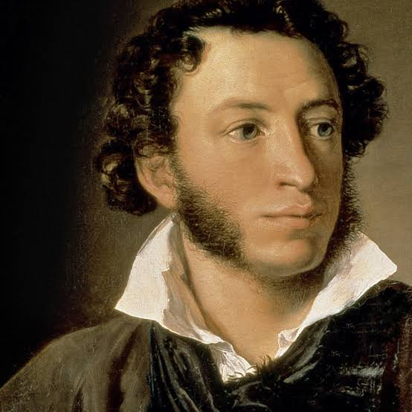
a very famous poem by Pushkin
假如生活欺骗了你，
不要悲伤，不要心急！
忧郁的日子里须要镇静：
相信吧，快乐的日子将会来临！
心儿永远向往着未来；
现在却常是忧郁：
一切都是瞬息，一切都将会过去；
而那过去了的，就会成为亲切的怀恋。

Slide 30
What’s the conditional statement in this poem?

Slide 31
in-class work
Write a conditional statement using the concept of 假如给我三天光明
Write a pseudocode to determine if a student's grade is passing. A grade of 60 or higher is considered a pass; otherwise, it is a fail.
Write a pseudocode to check if an integer is positive, negative, or zero and output the corresponding message.

Slide 32
Loops
FOR … TO … NEXT
REPEAT … UNTIL
WHILE … DO … ENDWHILE

Slide 33
The poem case
What’s the possible loop statement based on the previous poem?
What’s the possible loop statement of 假如给我三天光明
What’s the logic difference between REPEAT and WHILE

Slide 34
in-class work
Add from 1 to number n , which is an input from user
Give you a int, return whether it’s a prime number or not

